Slide 1
Moore and Mealy Machines
Prof. Deepali D. Ahir

Slide 2
What is FSM / FSA / SM?
It is a mathematical model of computation.
It is an abstract machine that can be in exactly one of a finite number of states at any given time.
The FSM can change from one state to another in response to some inputs.
The change from one state to another is called a transition.
An FSM is defined by a list of its states, its initial state, and the inputs that trigger each transition.
Types of FSM?
DFA,NFA(without output) Mealy machine, Moore machine (with output)

Slide 3
FSM with output
Mealy machine and Moore machine
NFA, DFA are limited to either accept or reject input/string
When to say i/p is accepted?
FSM can also be used as an output devices
These machines do not have final state
Generates an output on every input
Value of output is a function of current state and current input.
State transition function(δ)
Output function(λ)/machine function(MAF)

Slide 4
Mealy Machine
Mealy machine is a FSM with output value and its output depends on present state and current input symbol
The Mealy machine can be described by 6 tuples
(Q, ∑, q0, O, δ, λ)
where
Q: finite set of states
q0: initial state of machine
∑: finite set of input alphabet
O: output alphabet
δ: transition function where Q × ∑ → Q
λ: output function where Q × ∑ →O

Slide 5
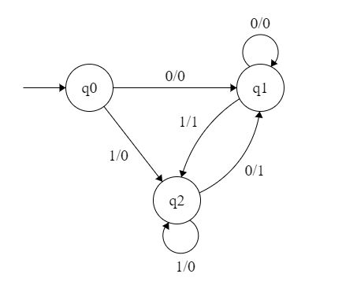
The output is represented with each input symbol for each state separated by /. The length of output for a mealy machine is equal to the length of input

Slide 6
State transition function(δ):
 | 0 | 1
q0 | q1 | q2
q1 | q1 | q2
q2 | q1 | q2

Slide 7
Output function/MAF(λ):
 | 0 | 1
q0 | 0 | 0
q1 | 0 | 1
q2 | 1 | 0

Slide 8
State table for both δ and λ:
 | 0 | 1
q0 | q1/0 | q2/0
q1 | q1/0 | q2/1
q2 | q1/1 | q2/0

Slide 9
Working of Mealy machine
Input :11
Transition:
δ (q0,11)=> δ(q2,1)=>q2
Output: 00 (q0 to q2 transition has Output 0 and q2 to q2 transition also has Output 0)
The length of output for a mealy machine is equal to the length of input.

Slide 10
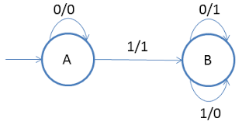
1. Design a Mealy machine to find 2’s complement of a given binary number
No: 0 1 0 1 1 0 1 0 0 0
2’s complement : 1 0 1 0 0 1 1 0 0 0

Slide 11
Find State transition function(δ)
Find Output function/MAF(λ)
Draw State table for both δ and λ

Slide 12
2. Design a Mealy machine that will read sequences made up of vowels of english language, it will give output in same sequences, except in case where a “i” follows “e” it will change to u.

Slide 13
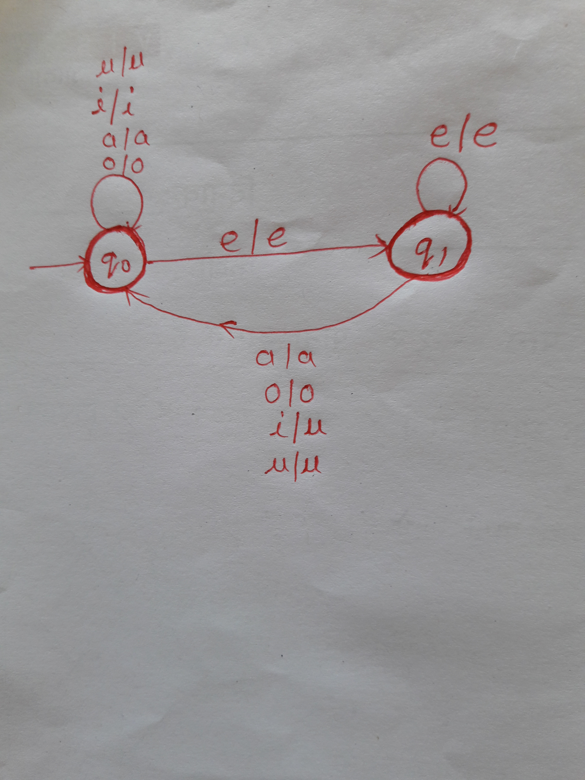
Design a Mealy machine that will read sequences made up of vowels of english language, it will give output in same sequences, except in case where a “i” follows “e” it will change to u.

Slide 14
3. Design a Mealy machine for input(0+1)*, if inputs ends in 101, output x; if input ends in 110, output y; otherwise output z.

Slide 15
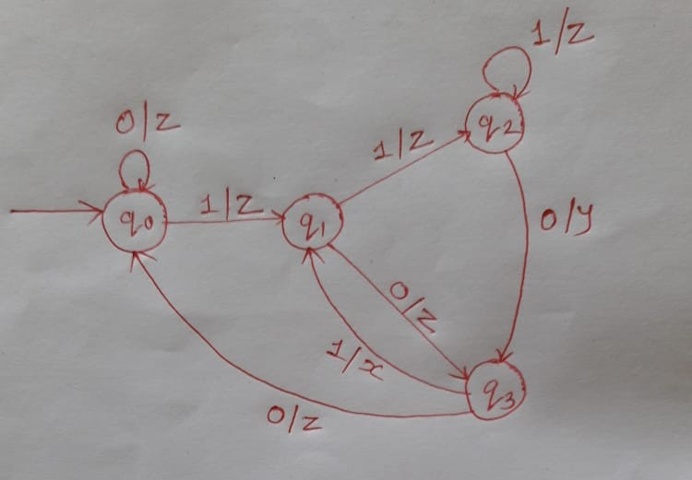
Design a Mealy machine for input(0+1)*, if inputs ends in 101, output x; if input ends in 110, output y; otherwise output z.

Slide 16
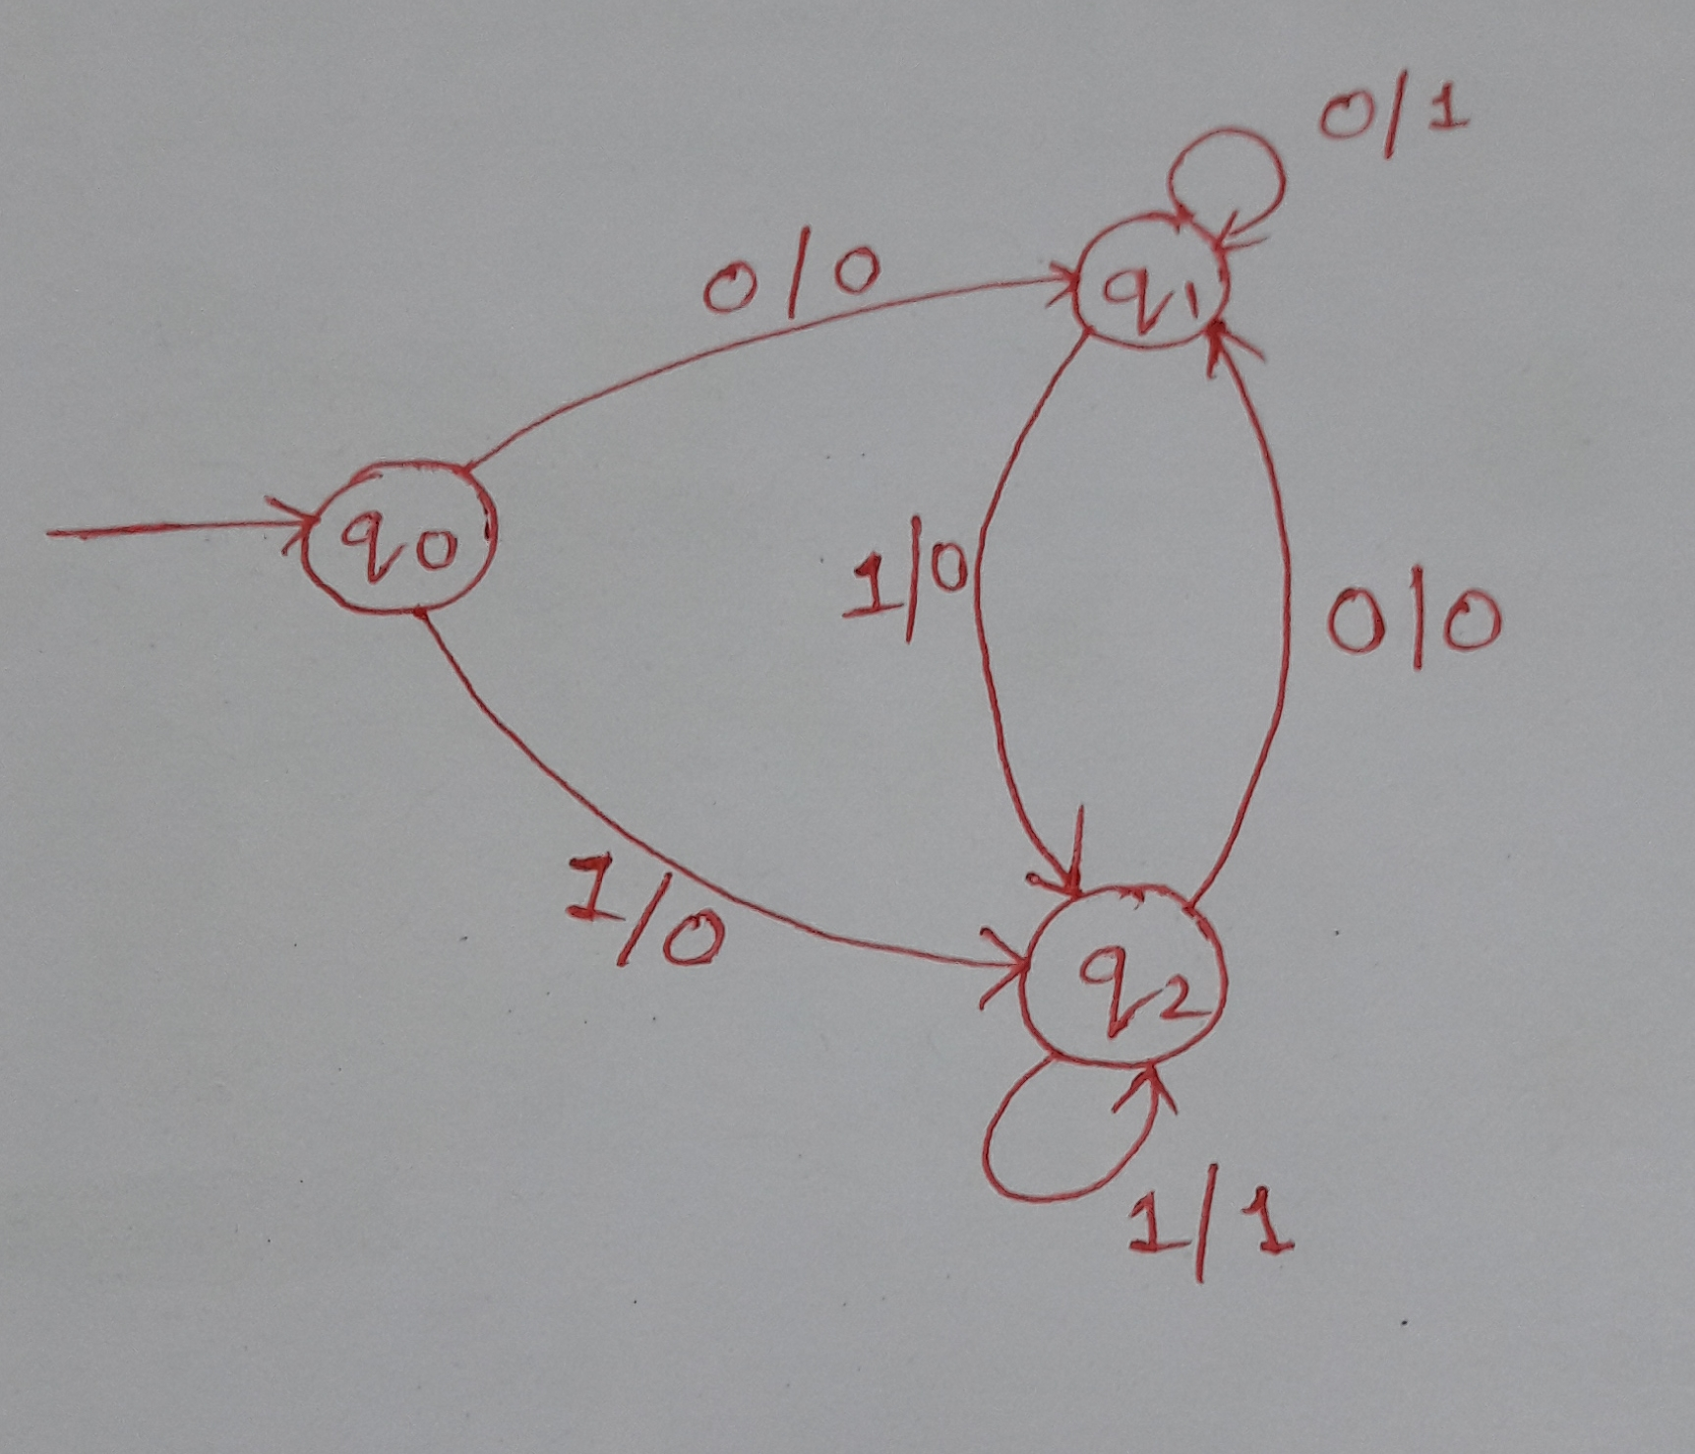
4. Design a mealy machine that accepts string ending in 00 and 11

Slide 17
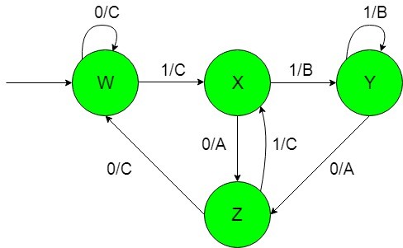
5. Design a mealy machine to produce ‘A’, ‘B’, ‘C’ depends on inputs that end with ’10’ or with ’11’ else other

Slide 18
Home Work
6. Design a Mealy machine for a binary input sequence such that if it has a substring 101, the machine output A, if the input has substring 110, it outputs B otherwise it outputs C.

Slide 19
Moore machines
Moore machine is a FSM with output value and its output depends only on present state.
The Mealy machine can be described by 6 tuples
(Q, q0, ∑, O, δ, λ) where:
Q is finite set of states.
q0 is the initial state.
∑ is the input alphabet.
O is the output alphabet.
δ is transition function which maps Q×∑ → Q.
λ is the output function which maps Q → O.

Slide 20
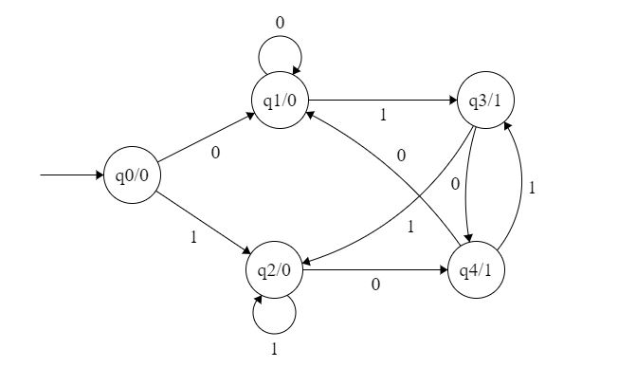
The output is represented with each input state separated by /.
The lengthof output for a moore machine is greater than input by 1

Slide 21
Input: 11
Transition: δ (q0,11)=> δ(q2,1)=>q2
Output: 000 (0 for q0, 0 for q2 and again 0 for q2)

Slide 22
Transition table for Moore Machine is:
Current State | Next State(δ) |  | Output(λ)
 | 0 | 1
q0 | q1 | q2 | 0
q1 | q1 | q3 | 0
q2 | q4 | q2 | 0
q3 | q4 | q2 | 1
q4 | q1 | q3 | 1

Slide 23
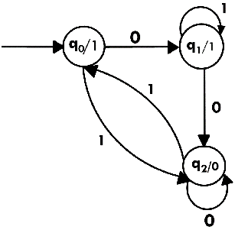
For input: 010, find transition and output.
Transition: δ (q0,0) => δ(q1,1) => δ(q1,0) => q2
Output: 1110(1 for q0, 1 for q1, again 1 for q1, 0 for q2)

Slide 24
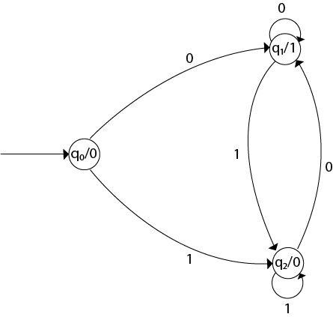
1. Design a Moore machine to generate 1's complement of a given binary number.
To generate 1's complement of a given binary number the simple logic is that if the input is 0 then the output will be 1 and if the input is 1 then the output will be 0.

Slide 25
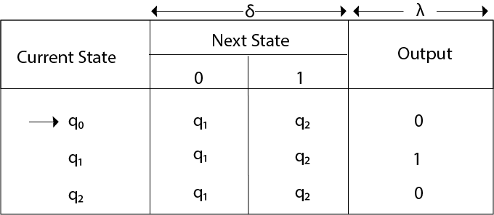
Input: 1011
Output: 00100
Neglect 1st 0, output which we get is 0100 which is 1's complement of 1011.

Slide 26
2. Design a Moore machine for a binary input sequence such that if it has a substring 101, the machine output A, if the input has substring 110, it outputs B otherwise it outputs C.

Slide 27
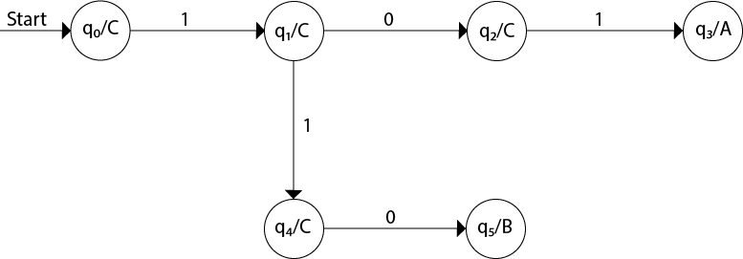
Q. Design a Moore machine for a binary input sequence such that if it has a substring 101, the machine output A, if the input has substring 110, it outputs B otherwise it outputs C.

Slide 28
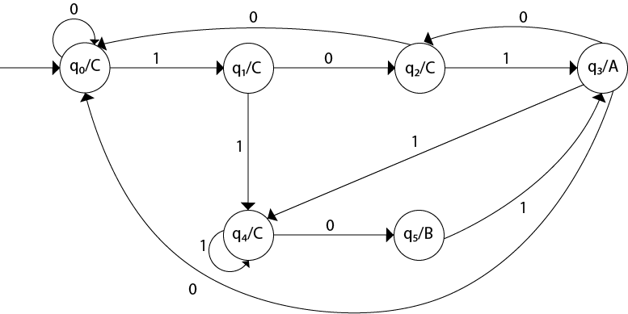
Now we will insert the possibilities of 0's and 1's for each state. Thus the Moore machine becomes:

Slide 29
3. Construct a Moore machine that determines whether an input string contains an even or odd number of 1's. The machine should give 1 as output if an even number of 1's are in the string and 0 otherwise.

Slide 30
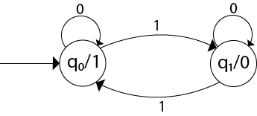
Q. Construct a Moore machine that determines whether an input string contains an even or odd number of 1's. The machine should give 1 as output if an even number of 1's are in the string and 0 otherwise.

Slide 31
4. Design a Moore machine with the input alphabet {0, 1} and output alphabet {Y, N} which produces Y as output if input sequence contains 1010 as a substring otherwise, it produces N as output.

Slide 32
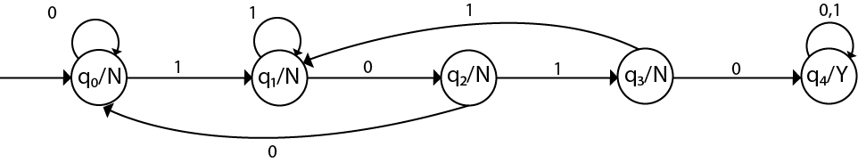
Design a Moore machine with the input alphabet {0, 1} and output alphabet {Y, N} which produces Y as output if input sequence contains 1010 as a substring otherwise, it produces N as output.

Slide 33
5. Design a Moore machine that gives an output 1 if the input string ends in bab

Slide 34
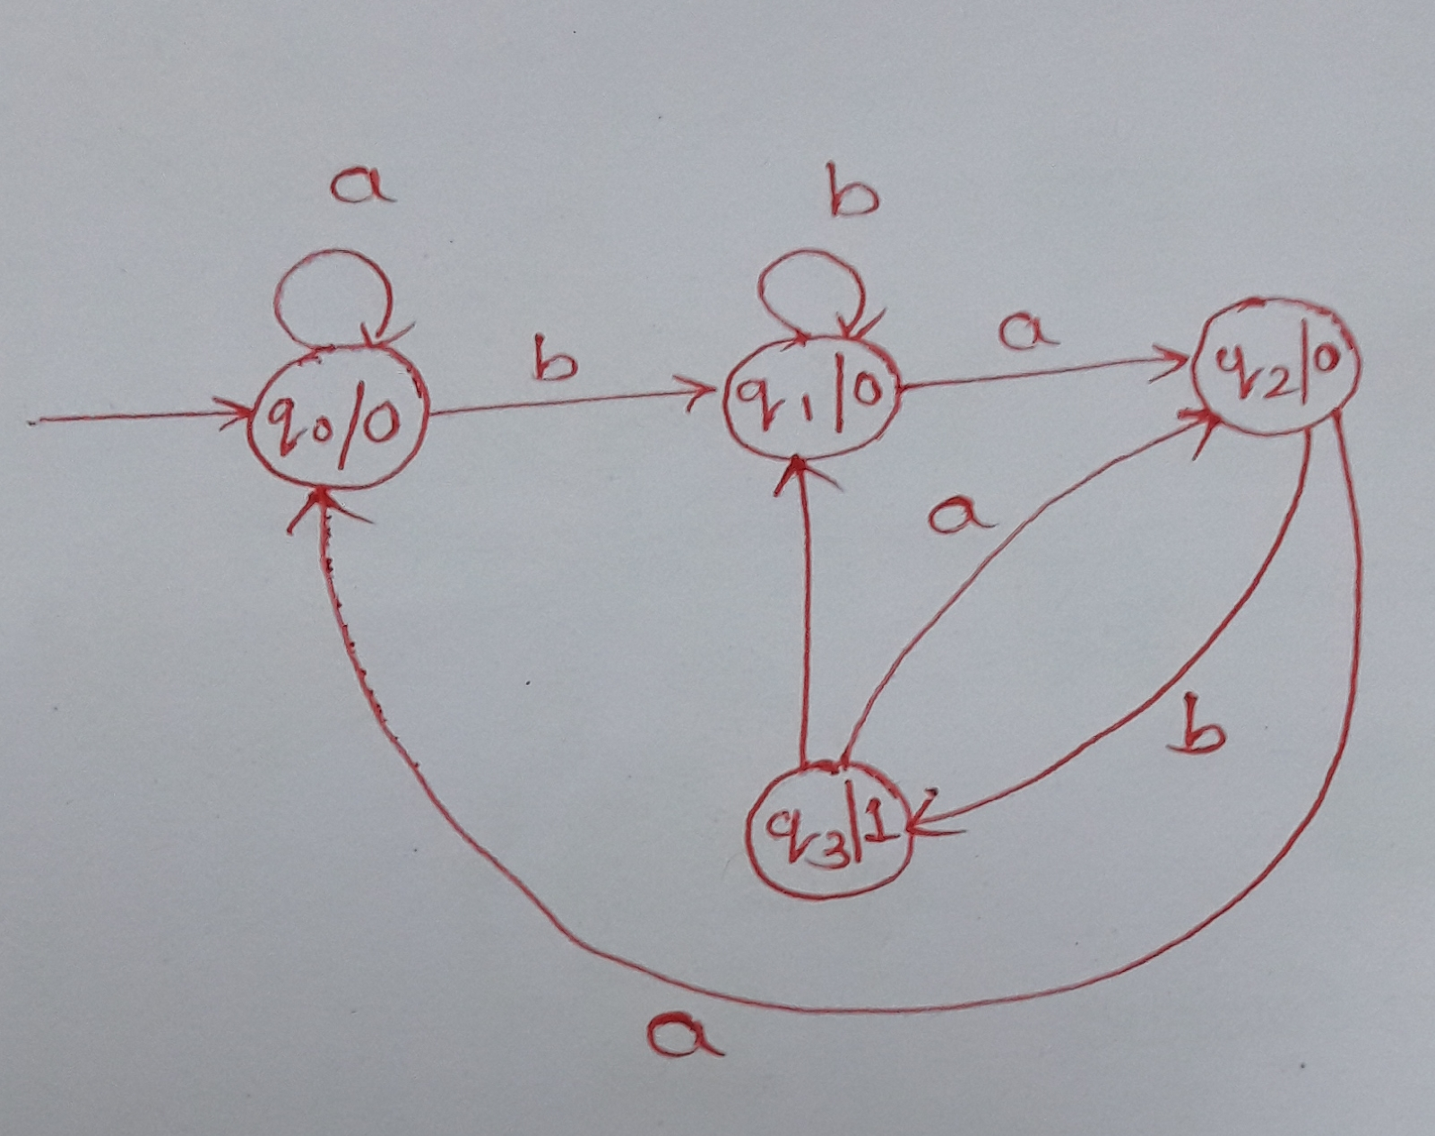

Slide 35
Mealy Machine | Moore Machine
Output depends both upon the present state and the present input | Output depends only upon the present state.
Generally, it has fewer states than Moore Machine. | Generally, it has more states than Mealy Machine.
The value of the output function is a function of the transitions and the changes, when the input logic on the present state is done. | The value of the output function is a function of the current state and the changes at the clock edges, whenever state changes occur.
Mealy machines react faster to inputs. They generally react in the same clock cycle. | In Moore machines, more logic is required to decode the outputs resulting in more circuit delays. They generally react one clock cycle later.

Slide 36
Conversion of Mealy machine into Moore machine

Slide 37
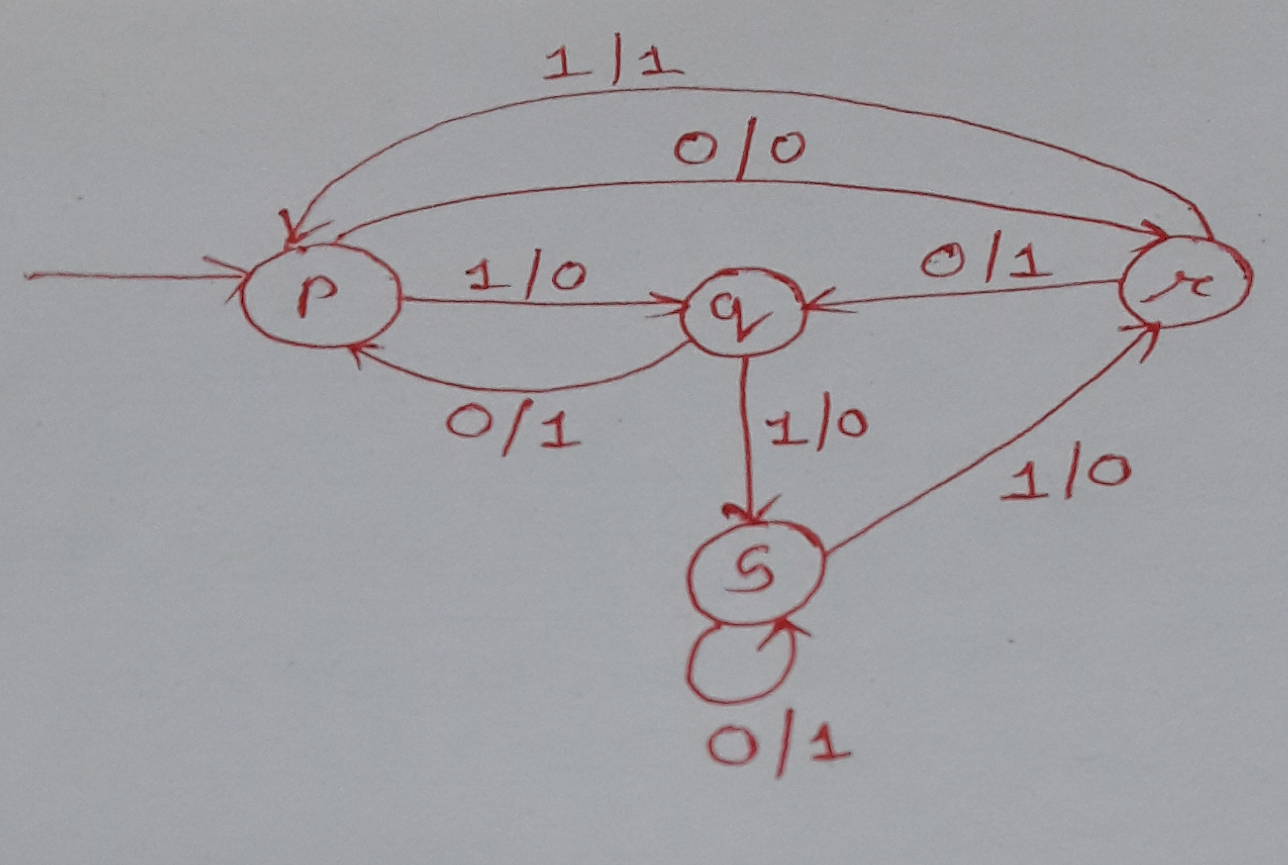
Splitting of states of Mealy machine to get an equvalent Moore machine.
Splitting is based on incoming eadges for the state and the assosiated outputs
Must split the state if the incoming eadges having different output .
___________________________________
There are 2 incoming lines to state p
1. From q with output 1
2. From state r with output 1
In every case output is 1 hence splitting is not required
There are 2 incoming lines into state q
1.From p with output 0
2.From r with output 1
since there are two different output, we must split q into two different states
q0 with output 0 : q0/0
q1 with output 1 : q1/1
There are 2 incoming lines into state r
1. From p with output 0
2. From s with output 1
Not need to split this state since output is same.
There are 2 incoming lines to state s
1.From s itself with output 1
2. From q with output is 0
Since there are two different output, splitting is required
s0 with output 0 : s0/0
s1 with output 1 : s1/1

Slide 38
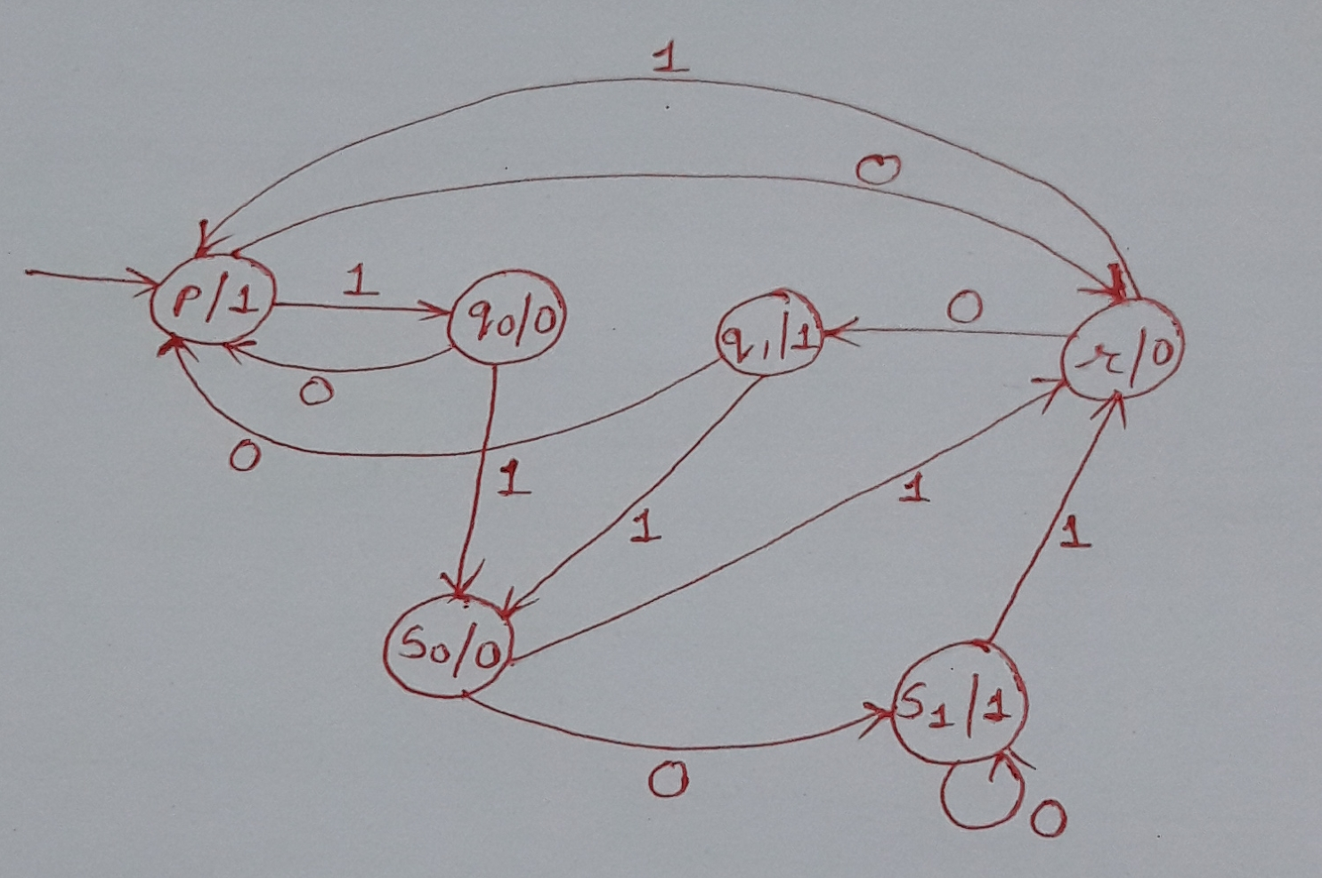
Moore machine here produces an output 1 without any input, it gives 1 on a zero length sequence and Mealy machine will not produce any output for a zero length sequence.
To handle this split the start sate p into two states:
Pε – for no output
P1 – for output 1

Slide 39
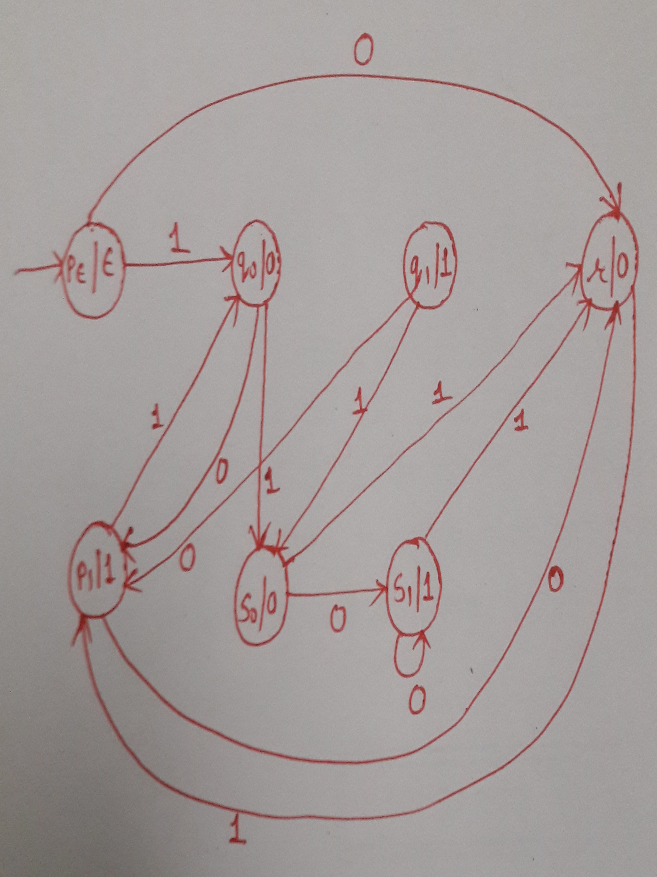

Slide 40
Convert following Mealy machine that accepts string ending in 00 and 11 into Moore machine

Slide 41
Step1: Splitting of States
1)q0
2)q1
3)q2
Step2: Drawing equivalent Moore machine

Slide 42
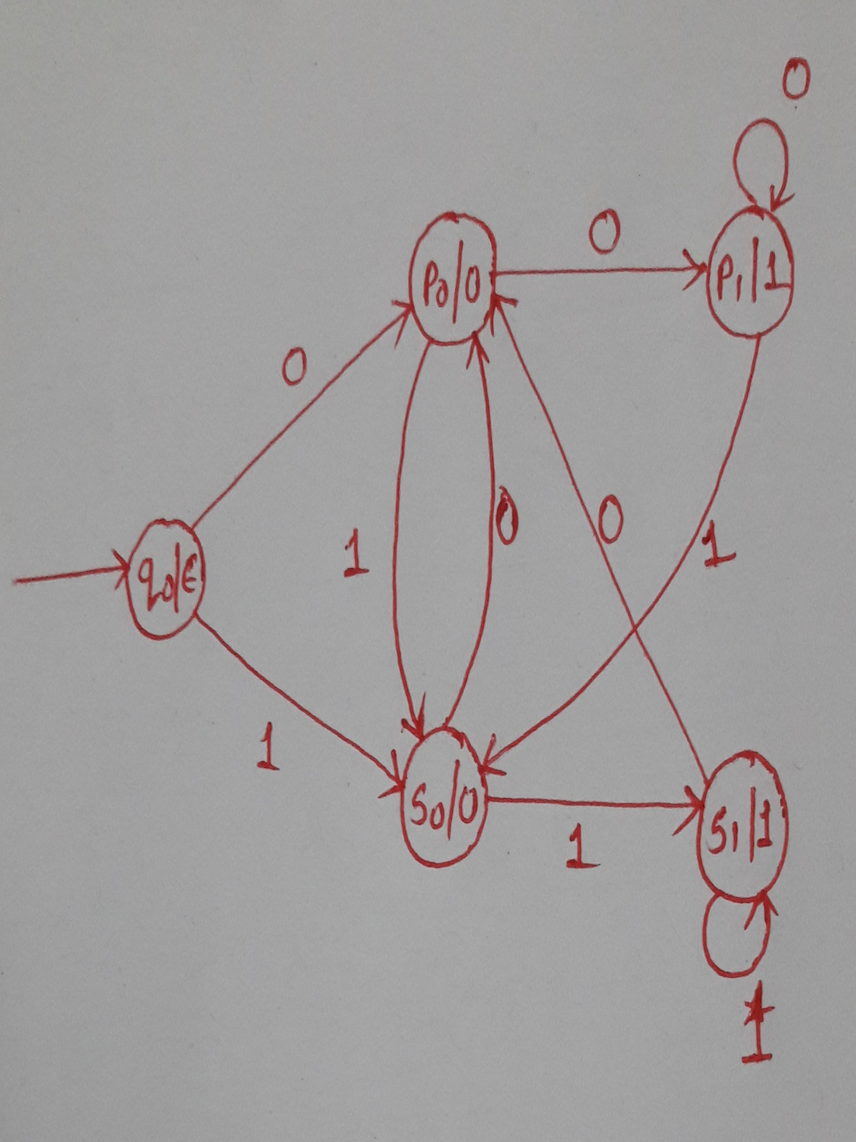

Slide 43
Convert following Mealy machine into Moore machine
Present State | Next State
 | a=0 |  | a=1
 | State | Output | State | Output
q1 | q1 | 1 | q2 | 0
q2 | q4 | 1 | q4 | 1
q3 | q2 | 1 | q3 | 1
q4 | q3 | 0 | q1 | 1

Slide 44
Step 1 Splitting of States:
1) Incoming edages to q1 :
2)Incoming edages to q2 :
3)Incoming edages to q3 :
4)Incoming edages to q4 :
Step 2: Drawing equvalent Moore machine
Step 3: Check for proper output
PS | Next State
 | a=0 |  | a=1
 | S | O | S | O
q1 | q1 | 1 | q2 | 0
q2 | q4 | 1 | q4 | 1
q3 | q2 | 1 | q3 | 1
q4 | q3 | 0 | q1 | 1

Slide 45
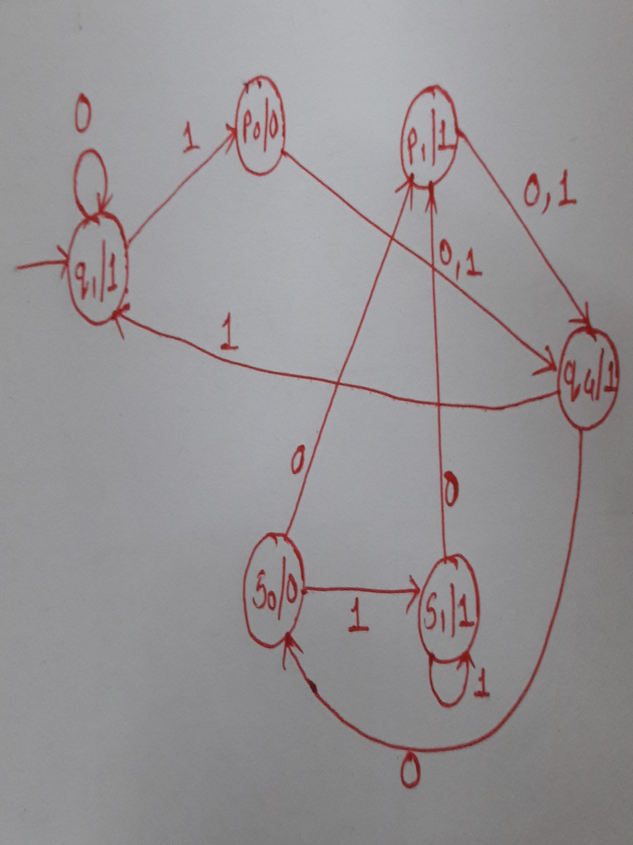
Step 2: Drawing equvalent Moore machine
Step 3: Check for proper output

Slide 46
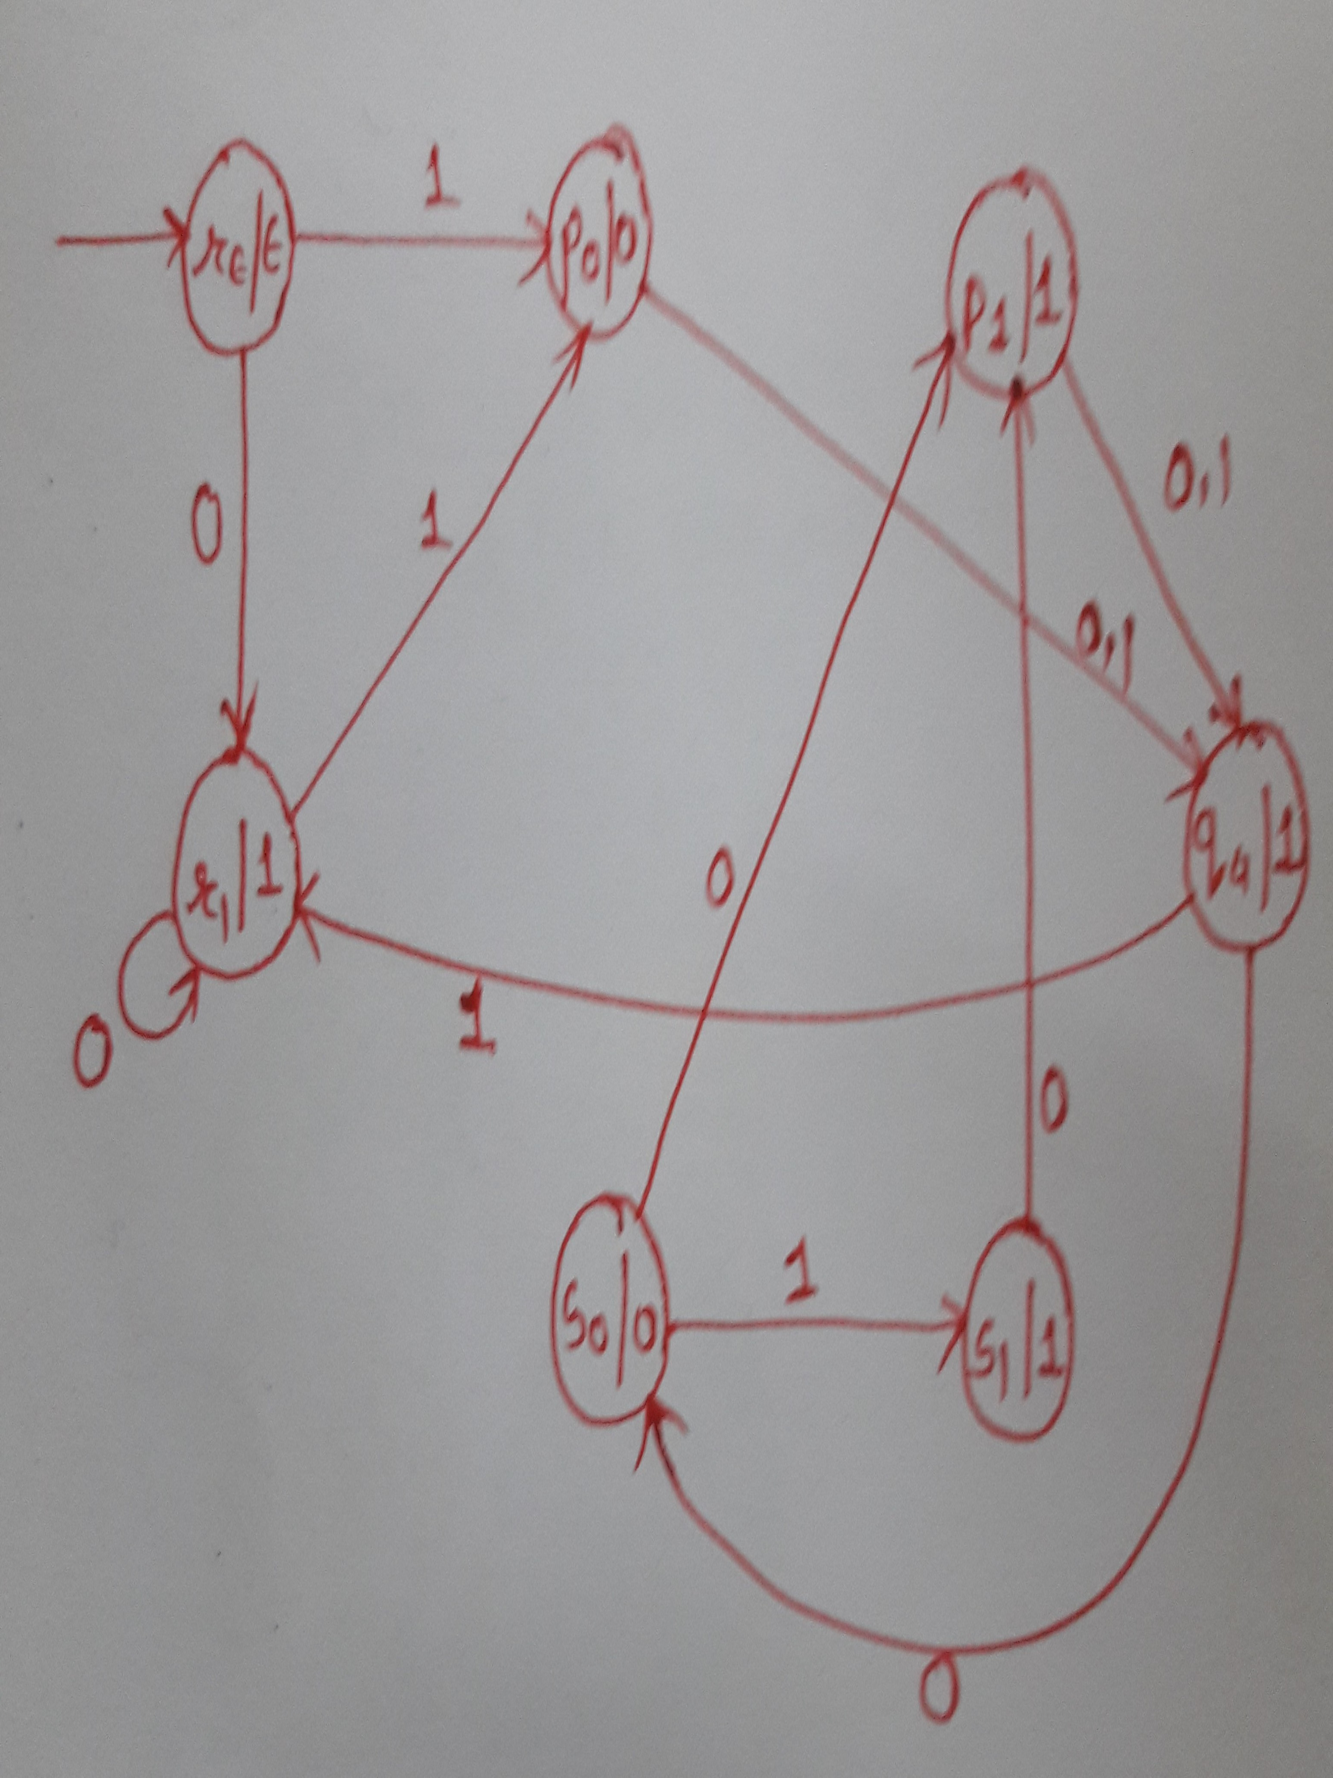

Slide 47
Conversion of Moore machine into Mealy machine

Slide 48
Moore machine can be converted into Mealy machine by following 2 steps:
Move output associated with a state to transition entering into that state(construction of trivial mealy machine)
Minimize the Mealy machine if possible

Slide 49
Present State | Next State |  | Output
 | 0 | 1
p | s | q | 0
q | q | r | 1
r | r | s | 0
s | s | p | 0
Step 1: construction of trivial Mealy machine
 | 0 | 1
p | S,0 | q,1
q | q,1 | r,0
r | r,0 | s,0
s | s,0 | p,0

Slide 50
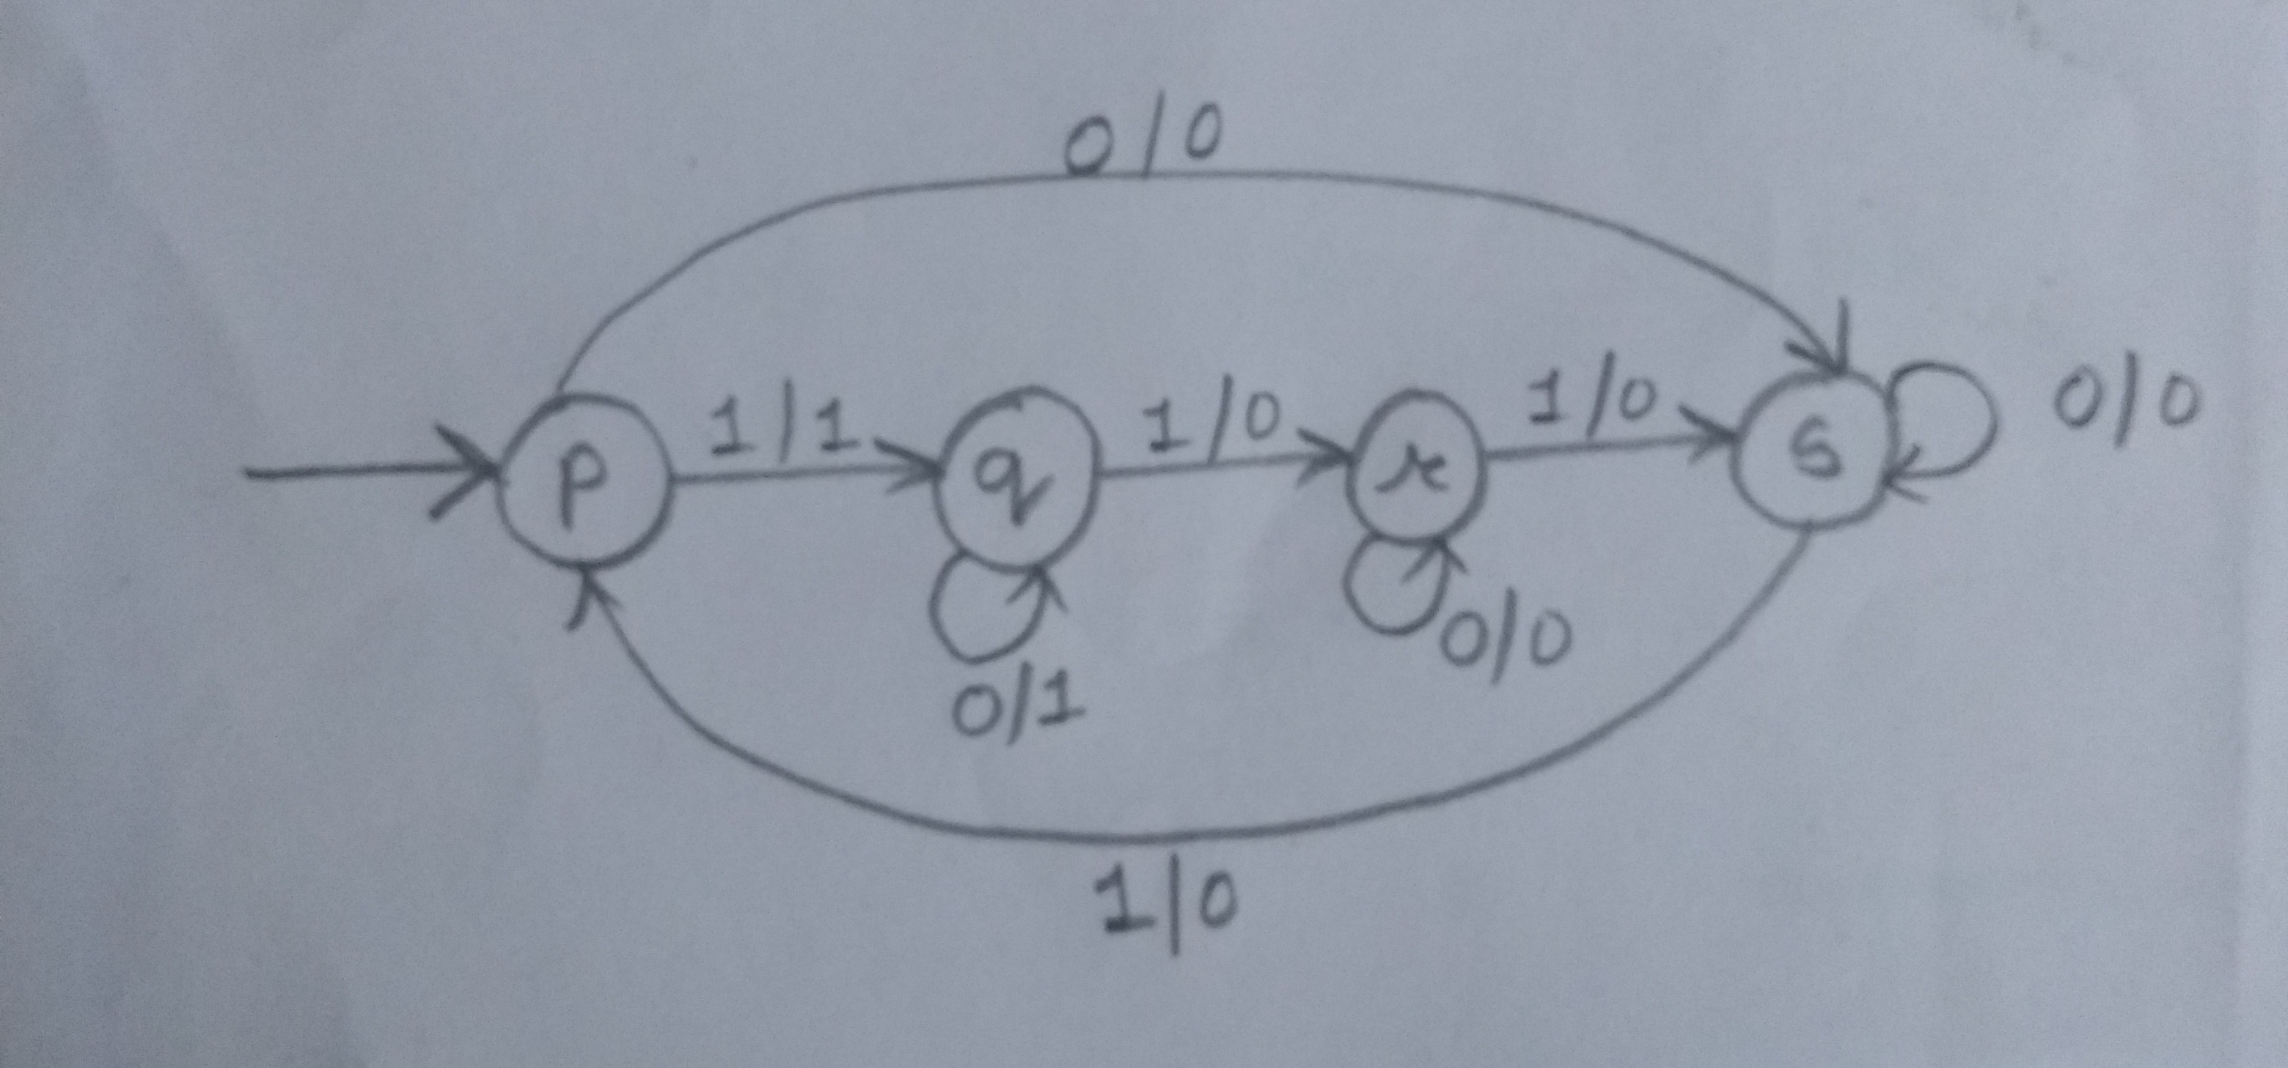
 | 0 | 1
p | S,0 | q,1
q | q,1 | r,0
r | r,0 | s,0
s | s,0 | p,0
Step 2 does not required for this example

Slide 51
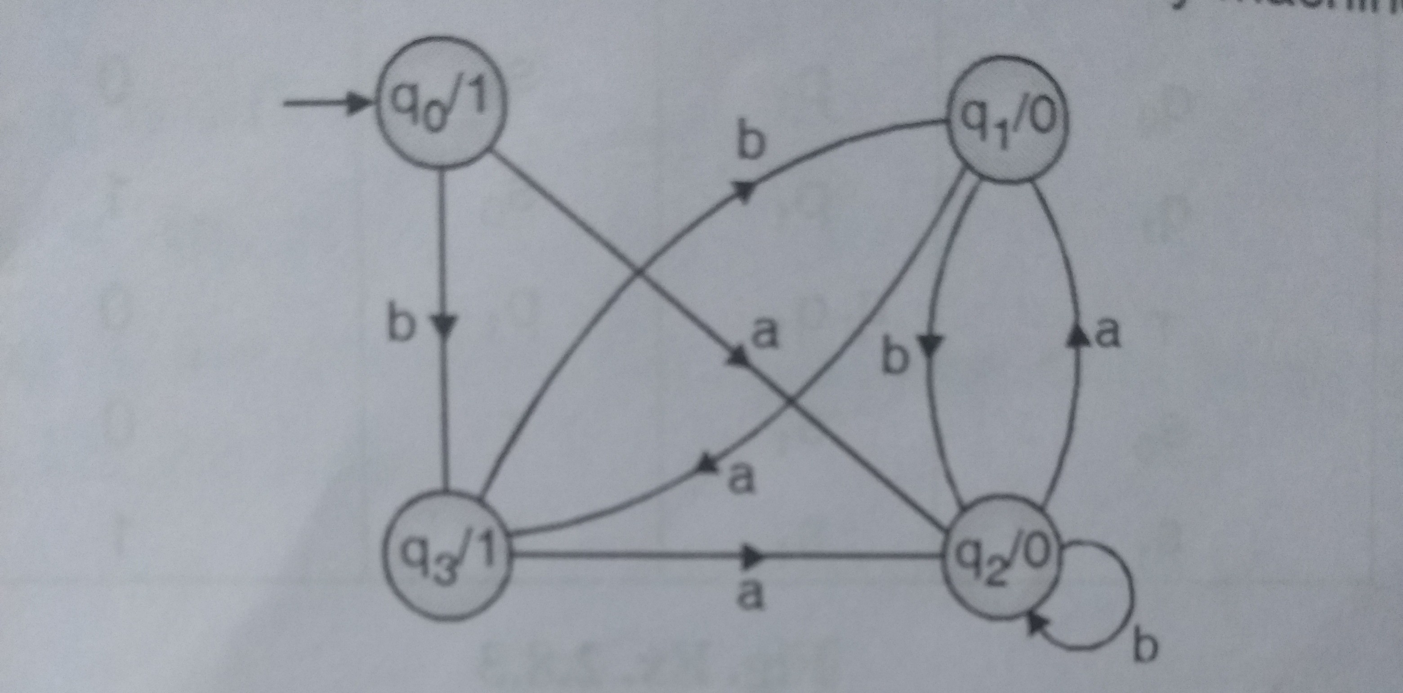
Convert following Mealy machine into Moore machine

Slide 52
Present State | Next State |  | Output
 | a | b
q0
q1
q2
q3
Step 1: construction of trivial Mealy machine
 | a | b
q0
q1
q2
q3

Slide 53
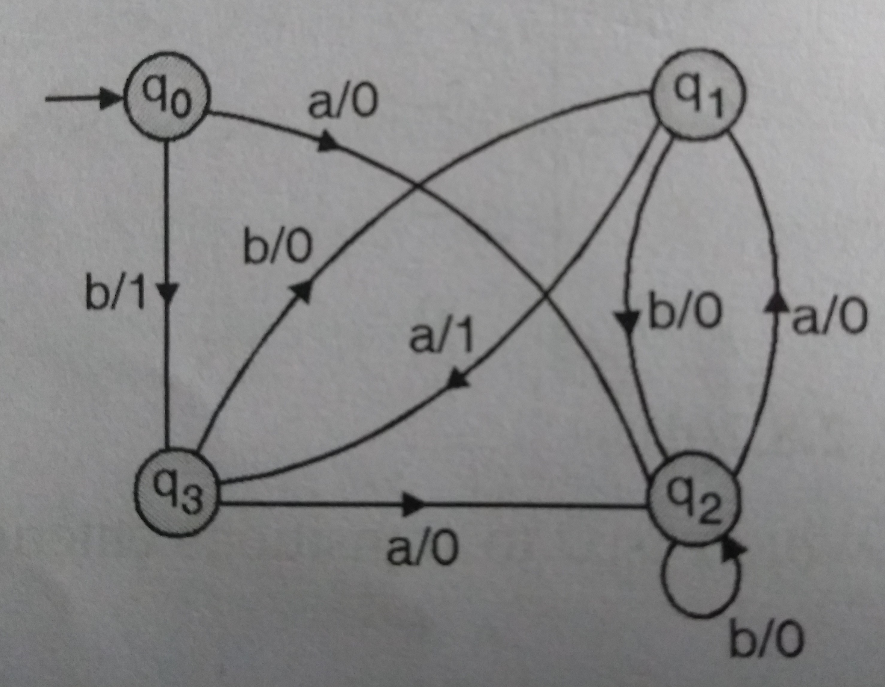

Slide 54
Present State | Next State |  | Output
 | 0 | 1
p0 | r | q0
p1 | r | qo | 1
q0 | p1 | s0 | 0
q1 | p1 | s0 | 1
r | q1 | p1 | 0
s0 | s1 | r | 0
s1 | s1 | r | 1
Present State | Next State |  | Output
 | 0 | 1
p0 | r | q0 | ε
p1 | r | qo | 1
q0 | p1 | s0 | 0
q1 | p1 | s0 | 1
r | q1 | p1 | 0
s0 | s1 | r | 0
s1 | s1 | r | 1
Present State | Next State |  | Output
 | 0 | 1
p0 | r | q0 | ε
p1 | r | qo | 1
q0 | p1 | s0 | 0
q1 | p1 | s0 | 1
r | q1 | p1 | 0
s0 | s1 | r | 0
s1 | s1 | r | 1
Present State | Next State |  | Output
 | 0 | 1
p0 | r | q0 | ε
p1 | r | qo | 1
q0 | p1 | s0 | 0
q1 | p1 | s0 | 1
r | q1 | p1 | 0
s0 | s1 | r | 0
s1 | s1 | r | 1
Present State | Next State |  | Output
 | 0 | 1
p0 | r | q0 | ε
p1 | r | qo | 1
q0 | p1 | s0 | 0
q1 | p1 | s0 | 1
r | q1 | p1 | 0
s0 | s1 | r | 0
s1 | s1 | r | 1
Present State | Next State |  | Output
 | 0 | 1
p0 | r | q0 | ε
p1 | r | qo | 1
q0 | p1 | s0 | 0
q1 | p1 | s0 | 1
r | q1 | p1 | 0
s0 | s1 | r | 0
s1 | s1 | r | 1
Present State | Next State |  | Output
 | 0 | 1
p0 | r | q0 | ε
p1 | r | qo | 1
q0 | p1 | s0 | 0
q1 | p1 | s0 | 1
r | q1 | p1 | 0
s0 | s1 | r | 0
s1 | s1 | r | 1
Q. Change the given Moore Machine into Mealy
Present State | Next State |  | Output
 | 0 | 1
p0 | r | q0 | ε
p1 | r | qo | 1
q0 | p1 | s0 | 0
q1 | p1 | s0 | 1
r | q1 | p1 | 0
s0 | s1 | r | 0
s1 | s1 | r | 1
Step 1: construction of trivial Mealy machine
Present state | 0 | 1
p0 | r,0 | q0,0
p1 | r,0 | q0,0
q0 | p1,1 | s0,0
q1 | p1,1 | s0,0
r | q1,1 | p1,1
s0 | s1,1 | r,0
s1 | s1,1 | r,0
q0
q0
Present State | 0 | 1
(po,p1)->q0 | q3,0 | q1,0
(q0,q1)->q1 | q0,1 | q2,0
(so,s1)->q2 | q2,1 | q3,0
r=q3 | q1,1 | q0,1
q1
q3
q2

Slide 55
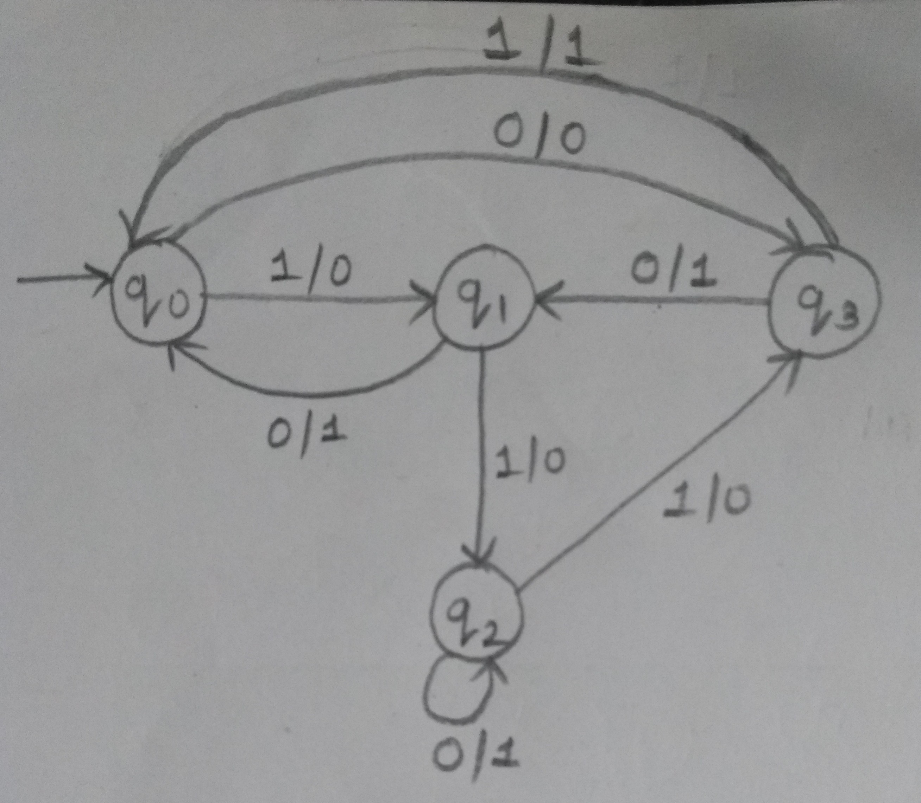
Present State | 0 | 1
(po,p1)->q0 | q3,0 | q1,0
(q0,q1)->q1 | q0,1 | q2,0
(so,s1)->q2 | q2,1 | q3,0
r=q3 | q1,1 | q0,1

